Slide 1
MUNICIPAL CAREER SPOTLIGHT
PRESENTATION
Insert Name of Municipality, Date
Notes:
Title slide
Update with the name of the municipality and the date of the event.

Slide 2
LEVELS OF GOVERNMENT IN CANADA
FEDERAL | PROVINCIAL | MUNICIPAL
Sports Arenas
Car Insurance
Animal Control
Highway #1
PST
Citizenship
Currency
Fire Services
Health Cards
Garbage Pick-up
Environment
Foreign Trade
Army
Postal Services
GST
Water/Wastewater
Child Welfare
Bylaw Enforcement
FEDERAL
PROVINCIAL
MUNICIPAL
Notes:
Levels of Government in Canada
In Canada, there are three different levels of government: federal, provincial, municipal. Can anyone explain what each of those levels mean or give examples of each?
Federal = Canada
Provincial = Saskatchewan, Manitoba, etc.
Municipal = City of Regina, Town of Nipawin, Rural Municipality of Lumsden No. 189, etc.
In the following exercise, you will work with a partner to decide which level of government is responsible for each of the items on the right. Once every group has completed the table, we will review the answers together.
Sports arenas (mun)
Car insurance (prov)
Animal control (mun)
Highway #1 (fed)
PST (prov)
Citizenship (fed)
Currency (fed)
Fire services (mun)
Health cards (prov)
Garbage pick-up (mun)
Environment (debatable – fed/prov)
Foreign trade (fed)
Army (fed)
Postal services (fed)
GST (fed)
Water/wastewater (mun)
Child welfare (prov)
Bylaw enforcement (mun)

Slide 3
TYPES OF MUNICIPALITIES
URBAN | RURAL | NORTHERN
CITIES | RURAL MUNICIPALITIES | NORTHERN TOWNS
TOWNS |  | NORTHERN VILLAGES
VILLAGES | Rural municipalities tend to have larger lot sizes, sparser population, farms, acreages, fewer shared services and are always numbered (for example, Rural Municipality of Big Stick No. 141). | NORTHERN HAMLETS
RESORT VILLAGES |  | THE DISTRICT
Urban municipalities tend to have smaller lots, shared services, street addresses, possibly a Main Street. |  | Northern municipalities are located in the Northern Saskatchewan Administration District (NSAD). Unincorporated areas of the NSAD are referred to as the “District”, which is one single municipality.
Notes:
Types of Municipalities
Read through this slide with students, provide further detail on the Northern Municipalities and answer any questions.
Northern Saskatchewan is all of the area north of Prince Albert National Park and is legally called the Northern Saskatchewan Administration District (NSAD). The unincorporated area of the NSAD is a municipality and is legally called “the district”. The district includes 11 northern settlements, 14 resort subdivision, 9 cluster subdivisions and upwards of 8,000 leases and excludes northern municipalities and designated Park land.

Slide 4
OTHER JURISDICTIONS IN SASKATCHEWAN
First Nations
Regional Parks
Provincial Parks
National Parks
Notes:
Other Jurisdictions in Saskatchewan
There are other jurisdictions in Saskatchewan that are within the boundary of a municipality but are not under the jurisdiction of a municipality. These include:
70 First Nations
Nearly 100 regional parks
36 provincial parks; and
2 national parks (Prince Albert National Park of Canada and Grassland National Park of Canada)

Slide 5
EXAMPLES OF MUNICIPALITES
URBAN | RURAL | NORTHERN
Notes:
Examples of Municipalities
Now that we know the different types of municipalities, let’s see which group can come up with the most examples of each type. You will have 5 minutes to list as many examples of each as you can. Good luck!
Examples:
Village of Chaplin
Resort Village of Grandview Beach
Town of Carnduff
City of Estevan
Rural Municipality of Corman Park
Northern Town of La Ronge

Slide 6
WHO’S THE HEAD?
LOCAL GOVERNMENT TYPE | HOW MANY IN SK? | MAYOR, REEVE, OR CHIEF?
 | 296
 | 250
 | 147
 | 25
 | 40
 | 16
 | 70
Cities Rural Municipalities Villages Resort Villages
Towns First Nations Northern Municipalities
Notes:
Who’s the Head?
This exercise will teach us more about the head of each type of local government and how many of each type is found in Saskatchewan.
In the first column on the left, take your best guess at how many of each type of local government is found in the province.
Answers:
Rural Municipalities – 296 – Reeve
Villages – 250 – Mayor
Towns – 147 – Mayor
Northern Municipalities – 25 – Mayor
Resort Villages – 40 – Mayor
Cities – 16 – Mayor
First Nations – 70 - Chief
We will check those results together, and then, once we know we have the right answers, we will see if we can guess the title of the head of that local government type. Good luck!

Slide 7
WHAT DO ELECTED OFFICIALS DO?
Municipal elected officials (or council members) include mayors, reeves and councillors. Mayors or reeves are referred to as the _________ of the council.
Council members are chosen (elected) by the ________ and serve _______ year terms.
The minimum number of council members a municipality can have is _____.
Council members represent the _______ and consider the well-being and interests of their municipality when making decisions.
Councils approve the annual budget for a municipality and determine property tax rates.
Councils establish policies, determine services and create _________ for the municipality.
Councils also make decisions related to __________ ___________ and development.
In larger communities, usually cities, being a council member is a full-time job. In smaller communities, council members often have other jobs and get an ________ for their council duties.
Notes:
What do elected officials do?
(read aloud to students and ask students to offer the answers to fill in the blanks)
Municipal elected officials (or council members) include mayors, reeves and councillors. Mayors or reeves are referred to as the HEADS of the council. They are the leader as noted in the previous slide.
Council members are chosen (elected) by the VOTERS and serve FOUR year terms.
The minimum number of council members a municipality can have is THREE.
Council members represent the PUBLIC and consider the well-being and interests of their municipality when making decisions.
Councils approve the annual budget for a municipality and determine property tax rates.
Councils establish policies, determine services and create BYLAWS for the municipality.
Councils also make decisions related to LAND USE and development.
In larger communities, usually cities, being a council member is a full-time job. In smaller communities, council members often have other jobs and get an INDEMNITY for their council duties.

Slide 8
WHERE DOES THE MONEY COME FROM?
There are two types of budgets that a council needs to approve every year:
  ___________________: the money needed to keep the lights on in the arena, the roads clear of snow, etc.
  ___________________: the money needed to pay for new infrastructure, etc.
The main source of revenue (money coming in) to the municipality is through _________________ ______________. This is paid by home owners, business owners and other land owners.
The federal and provincial governments also provide money to municipalities through _________________.
  This money helps pay for projects such as ______________ _______________ _______________ and ____________.
Currently, the provincial government sets aside a portion of the Provincial Sales Tax (PST) and divides it up among all the municipalities in Saskatchewan in a program called __________ __________ __________.
  In 20XX-XX, [municipality name] received a total of [$] in grants from the province.
Currently, the federal government distributes a portion of the tax money collected on gasoline sales and divides it up among eligible municipalities across Canada in a program called the ________ ________ _________.
  In 20XX-XX, the [municipality name] received a total of [$] from this program.
Notes:
Where does the money come from?
(read aloud to students and offer the answers to fill in the blanks)
There are two types of budgets that a council needs to approve every year:
OPERATING BUDGET: the money needed to keep the lights on in the arena, the roads clear of snow, etc.
CAPITAL: the money needed to pay for new infrastructure, etc.
The main source of revenue (money coming in) to the municipality is through PROPERTY TAXES. This is paid by home owners, business owners and other land owners.
The federal and provincial governments also provide money to municipalities through GRANTS.
This money helps pay for projects such as DRINKING WATER FACILITIES and LAGOONS.
Every year, the provincial government sets aside a portion of the Provincial Sales Tax (PST) and divides it up among all the municipalities in Saskatchewan in a program called MUNICIPAL REVENUE SHARING.
In 20XX-XX, [municipality name] received a total of [$] in grants from the province.
Every year, the federal government distributes a portion of the tax money collected on gasoline sales and divides it up among eligible municipalities across Canada in a program called the FEDERAL GAS TAX FUND PROGRAM.
In 20XX-XX, the [municipality name] received a total of [$] from this program.

Slide 9
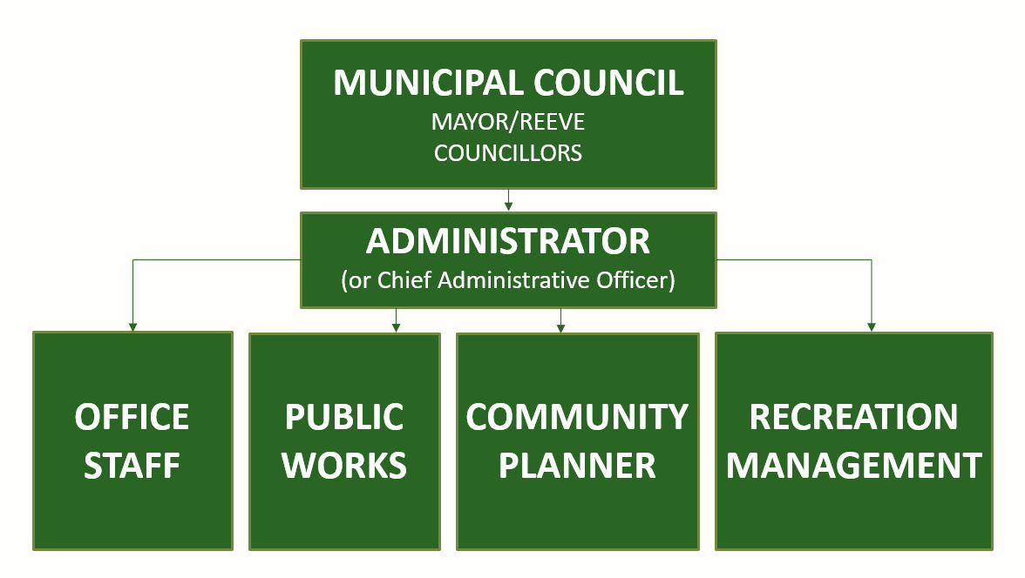
MUNICIPAL ORGANIZATIONAL CHART
Notes:
Municipal Organization Chart
(go through the organization chart and you can briefly discuss duties of the other positions)

Slide 10
WHAT DO ADMINISTRATORS DO?
Administrators are _______________ or hired by council. Every municipality must have an _______________.
They are responsible for the day-to-day operations of the municipality, including:
  Managing the ______________ in a municipal office;
  Advising ____________ on legislative responsibilities and municipal policies and procedures,
  Attending _____________ _____________, recording council decisions and relaying decisions of council to the _______________;
  _________ (charging) and ___________ taxes from citizens in the municipality;
  Ensuring municipal _________ are spent and received as required;
  Preparing _____________ statements and other financial reports that may be required;
  Overseeing municipal __________ (property – from equipment to buildings) and planning for the repair, maintenance and ______________ of those assets;
  Enforcing bylaws (local laws) unless they have a ___________ _________________ ___________;
  Keep _____________ of the municipality safe (e.g. meeting minutes, bylaws, etc.).
Notes:
What do Administrators Do?
(read aloud to students and offer the answers to fill in the blanks)
Administrators are APPOINTED or hired by council. Every municipality must have an ADMINISTRATOR
They are responsible for the day-to-day operations of the municipality, including:
Managing the STAFF in a municipal office;
Advising COUNCIL on legislative responsibilities, municipal policies and procedures;
Attending COUNCIL MEETINGS, recording council decisions and relaying decisions of council to the PUBLIC;
LEVYING (charging) and COLLECTING taxes from citizens in the municipality;
Ensuring municipal FINANCES are spent and received as required;
Preparing FINANCIAL statements and other financial reports that may be required;
Overseeing municipal ASSETS (property – from equipment to buildings) and planning for the repair, maintenance and REPLACEMENT of those assets;
Enforcing bylaws (local laws) unless they have a BYLAW ENFORCEMENT OFFICER; and
Keep RECORDS of the municipality safe (e.g. meeting minutes, bylaws, etc.).

Slide 11
WHY BECOME AN ADMINISTRATOR?
Being a municipal administrator is essentially the head operating officer of a multi-million-dollar corporation.
You would hold a prominent position in your municipality and would be in a position to effect positive change for your community.
You could pursue a dynamic career while getting to stay in your own community near friends and family. Moving to another community and finding another job as an administrator is easy, as your skills and certification could transfer to other municipalities all over the province.
You could earn an impressive salary, and receive health benefits and a generous pension.
  Rural municipal administrators can expect to earn between $53,000 to more than $89,000 per year, depending on the municipality and your qualifications.
  Urban municipal administrators can earn from $39,000 to $139,000 per year, depending on qualifications and the size of the municipality.
Notes:
Why Become an Administrator?
(read aloud to the students and answer any questions)

Slide 12
ARE YOU …?
Interested in making a difference in your community?
Excited by challenges?
Good with finances and numbers?
Level-headed in a crisis?
Able to multi-task?
Assertive?
Eager to lead?
Detail-oriented?
Looking for a dynamic career that will keep you close to home?
… CONSIDER BECOMING A MUNICIPAL ADMINISTRATOR!
Notes:
Are you….?
(read aloud to the students and answer any questions)

Slide 13
BECOMING AN URBAN ADMINISTRATOR
STEP #1: STUDY
(Choose one of the following programs)
STEP #2: WORK
STEP #3: GET CERTIFIED
Certificate in Local Government Authority
University of Regina (online option)
Get experience working in a muncipal office.
You will need a minimum of 1,800 hours (one year) experience working in a municipality.
This can be done by working as an assistant administrator under the supervision of a certified administrator. There are also mentoring options available.
Apply to the Urban Board of Examiners for a Standard Certificate.
Higher levels of accreditation are available with further study and experience.
OR
Public Admin Certificate or
Business Admin Certificate
(from an accredited college or institute)
OR
Bachelor of Commerce, Business or Public Administration
(from an accredited university)
Notes:
Becoming an Urban Municipal Administrator
(read aloud to the students and answer any questions)

Slide 14
BECOMING A NORTHERN ADMINISTRATOR
STEP #1: STUDY
(Choose one of the following programs)
STEP #2: WORK
STEP #3: GET CERTIFIED
Certificate in Local Government Authority
University of Regina (online option)
Get experience working in a muncipal office.
You will need a minimum of 1,800 hours (one year) experience working in a municipality.
This can be done by working as an assistant administrator under the supervision of a certified administrator. There are also mentoring options available.
Apply to the Urban Board of Examiners for a Standard Certificate.
Higher levels of accreditation are available with further study and experience.
OR
Public Admin Certificate or
Business Admin Certificate
(from an accredited college or institute)
OR
Bachelor of Commerce, Business or Public Administration
(from an accredited university)
Notes:
Becoming a Northern Municipal Administrator
The qualifications for a Northern Municipal Administrator are the same as the qualifications to become an Urban Municipal Administrator.
One of the differences between the two is that for the northern municipalities, a certified administrator is required to be appointed for northern municipalities of population of 500 or more. Northern municipalities with less than 500 population can appoint a clerk with less qualifications than an administrator.
Urban municipalities require a certified administrator when they have a population of 100 or more.

Slide 15
BECOMING A RURAL ADMINISTRATOR
STEP #1: STUDY
(Choose one of the following programs)
STEP #2: WORK
STEP #3: GET CERTIFIED
Certificate in Local Government Authority
University of Regina (online option)
Get experience working in a muncipal office.
You will need a minimum of 1,800 hours (one year) experience working in a municipality.
This can be done by working as an assistant administrator under the supervision of a certified administrator. There are also mentoring options available.
Apply to the Rural Board of Examiners for a Class C Certificate.
Higher levels of accreditation are available with further study and experience.
OR
Public Admin Certificate or
Business Admin Certificate
(from an accredited college or institute)
OR
Bachelor of Commerce, Business or Public Administration
(from an accredited university)
Notes:
Becoming a Rural Municipal Administrator
(read aloud to the students and answer any questions)

Slide 16
MORE QUESTIONS?
RMAA - Rural Municipal Administrators’ Association of Saskatchewan
  www.rmaa.ca
UMAAS - Urban Municipal Administrators Association of Saskatchewan
  www.umaas.ca
SARM – Saskatchewan Association of Rural Municipalities
  www.sarm.ca
SUMA – Saskatchewan Urban Municipalities Association
  www.suma.org
New North – Saskatchewan Association of Northern Communities
  www.newnorthsask.org
Municipal Administration – Government of Saskatchewan
  www.saskatchewan.ca/government/municipal-administration
Notes:
More Questions?
(read aloud to the students and answer any questions)

Slide 17


